Slide 1
Matthew J. Spaniol, PhD nicholas j. rowland, phd
Intersecting futures studies and sts
Warwick 2018

Slide 2
Architecture of Contributions
 | Facilitation in Practice | Patterns in Academic Inquiry
Processes under Study | “Social Foundations” (2017) | “Planning Paradox” (2018; 2018)
Objects under Study | “The Future Multiple” (2015) | “Defining Scenario” (2018)
Links:
The future multiple
Social foundations of scenario planning
The scenario planning paradox
Defining scenario

Slide 3
Links to videos of flowchart presentations
Short (7 minutes)
https://vimeo.com/300695632/a89fa34029
Long (17 minutes)
https://vimeo.com/295573387/c384121fdb

Slide 4

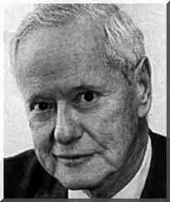
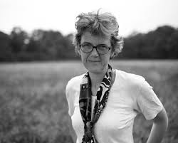
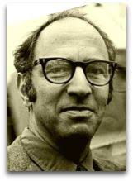
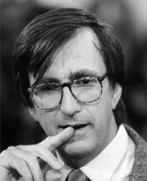
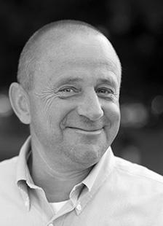
Science Studies
Controversy & closure
Sergio Sismondo
The provision of certified knowledge
Robert K. Merton
Ontological multiplicity
Paradigm shift
Annamarie Mol
Thomas Kuhn
Logical constructivism
Science is culture
Bruno Latour
Jens Bartelson
Notes:
Standing on the shoulders of giants is not catch phrase google scholar just came up with. It gives scholarly research the entrypoint into inquiry. If this dissertation is able to contribute, the geneology of thought coming through science studies points the way. Sceince studies, also known as the sociology of science, science and technology studies or STS, was pioneered by Robert King Merton. Merton inquired into the social practices that lead to the provision of certified knowledge. He identified a set of values that the scientific community embraced. He gave us many elegent concepts- self-fulfilling prophecy/manifest and latent functions/Unintended consequences and the Focus group approach to research.
Thomas Kuhn upended science with his book, the SSR – now with over 99K citations. Kuhn broke away from the ”recieved view” of science. Let me explain: Until Kuhn, the history of S&T was written largely by late-career scientists who depicted the growth of knowledge and technology as progressing in a smooth, linear fashion. Kuhn, a physicist, told a different story, ofe of science as a volitile enterprise. He described science as it moves through paradigms, first a pre-paradigmatic stage, and then a stage of normal science. Normal science allowed for an efficient solving of an increasing number of puzzles. However, in this stage, anomolies would appear and start to build up. A battle would then ensue between the old guard – the established scientists and younger ones who begin to use more advanced theories. The resolution would result in a paradigm shift as the old theories would be replaced by the revolutionary ones in a social struggle. Kuhn’s view would challenge the thinking about science, and even call into question the enlightenment itself.
Kuhn explained this by the behavior of the scientists, and their training protocols – and provides the foundation for a radical constructivism challenges the notions of ”objective criteria”;
Bruno Latour would build off of Kuhn, but incoporate a different approach: ethnomethodology. Since the early 19th century, anthropologists would travel to remote islands and deep jungles to study distant cultures. Latour himself did this as a young researcher in the Ivory Coast. But what if, instead of studying remote cultures, we send the social scientist to study other scientists in their most sacred setting: the laboratory? Here, Latour would study science as it actually happens in real-time—in practice.
The insights generated by Latour, Kuhn and Merton have supplemented the power of science and technology by supplementing and complementing the advancements gained from a positivistic approach.
These are the giants that provide the research lens from which the contributions of this dissertation is assembled.
-oral traditions
-specific practices
Ethnomethodology- Garfinkel; Semiotics- Greimas
Late 70s – when lots of anthropologists were entering the laboratories
How scientists manage inconclusive data-
Political biography of the experiment, evidence, and reason
Specific, anecdotal approach: paying close attention to the details of practice
The production and refinement of statements of truth; the patterns of citations

Slide 5
Bradfield (2008)
“Even the term scenario itself is not a very precisely defined concept (Jungermann, 1985a; Jungermann & Thuring, 1987); it means different things to different people and, accordingly, is labeled and applied in widely divergent ways and the term elicits “all kinds of vague and loosely defined concepts” (Simpson, 1992, p. 13). The consequence according to Khakee (1991) is that “few techniques in futures studies have given rise to so much confusion as scenarios” (p. 52). This confusion may be explained by the fact that unlike other long-range forecasting methods there appears to be no solid theoretically based foundation underpinning scenario techniques. As a number of writers have noted, there is in fact “a paucity of systematic research” (Kuhn & Sniezek, 1995, p. 148), leading Chermack (2002) to conclude that “the status of theory development in the area of scenario planning is dismal” (p. 25).”
Bradfield, R. M. (2008). Cognitive barriers in the scenario development process. Advances in Developing Human Resources, 10(2), p. 199.
Notes:
Fast forward to contemporary times, the IL approach is the most widely used approach. It is preminent in the UK, S.A. Austrailia. Bradfield, together with other scholars at the University of Strathclyde, is one of the most established thinkers in the field of scenario planning.
Let’s read this together
This paragraph, and paragraphs similiar to this are commonplace in the scenario planning literature. It is the door to all sorts of inquiry; for an early stage researcher such as myself, it is more like a looming mountain.

Slide 6
the problem of defining ‘scenario’
It is “[o]ften with great conviction the champions of various definitions try to convince others that their particular notion is the correct one; that the other animals that may be presented to them bearing the label "scenario" are really something else in disguise - possibly "contexts," "situations," "plans," "assumptions," "parameter values," but "certainly nothing you ought to be calling a scenario."
p. 299 in Brown, S. (1968). Systems Analysis and Policy Planning: Applications in Defense. In E. S. Quade & W. I. Boucher (Eds.), Systems Analysis and Policy Planning: Applications in Defense (pp. 298–310). New York: American Elservier Publishing Company, Inc.
Notes:
Let’s start by going back in the past to 1968 to the origins of the scholarly study of scenarios.
Where the problem of defining scenario was first clearly identified
By Seymon Brown, working at the RAND corporation, described that…

Slide 7
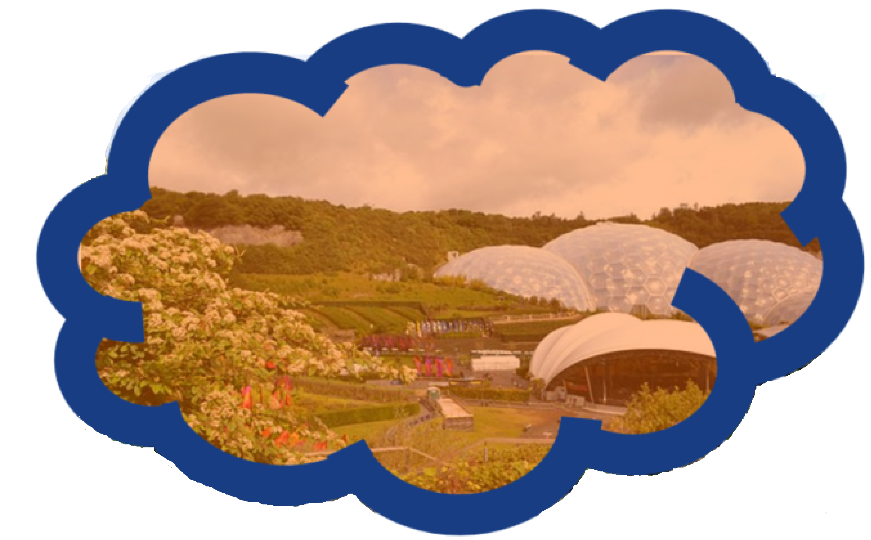
Scenario-based +…
Planning
Discussions
Deliberations
Conversations
Exercizes
Modelling
Risk analysis
Thinking
Learning
Discovery
Notes:
In the contemporary scholarly literature, the word scenarios is often used as a compound modifier- together with based,
Scenarios modify our
nterpersonal communication
Cognitive exploration and activity
Can change the application of other tools and techniques
But what is a scenario, in and of itself?

Slide 8
The quizzical
Images of the future,
maps of the future landscape,
artificial case histories,
future histories,
past futures
leaps and jumps into the future,
disciplined imagination,
mental time travel,
memories from the future,
awkward forms of evidence,
Not to mention the dominant tradition itself referred to as “intuitive logics.”
Notes:
Unlearning
Re-percieving
The literature on scenario planning suggests many ideas and metaphors to attempt at a definition
Unfortunately, they are quizzical, and although interesting to contemplate, does not seem to get us closer to a definition.
So let’s go back in time again to the origins of scenario planning.
(Suddendorf & Corballis, 2007)

Slide 9
method
… searched a digital library of extant scholarly literature consisting of reports, books, and peer-reviewed journal articles, primarily in the IL tradition dating back to 1967. The search for phrases “a scenario is” and “scenarios are” in the complete library of texts yielded 405 references for extraction.

Slide 10
Appraisal
1. Exclude statements that raise but do not define scenario. For example, exclude statements like scenarios are “a central element in” scenario planning (Balarezo, 2015, p. 38).
2. Exclude negative definitions; include positive definitions. For example, scenarios are “...different from forecasts, prognoses and visions” is a negative definition of what scenarios are not, and, thus, excluded (Lindgren & Bandhold, 2003, p. 22).
3. Include original, paraphrased, and quoted definitions. For example, Chermack & Lynham’s (2002, p. 376) definition -- scenarios are “several informed, plausible, and imagined alternative future environments in which decisions about the future may be played out” -- is included.

Slide 11
Vocabulary (& frequency)
17. Different (8);
18. Element (8);
19. Several (8);
20. Condition (7);
21. Situation (7);
22. Part (7);
23. World (7);
24. Number (6);
25. Model (5);
26. Range (5);
1. Future (85);
2. Description (28);
3. Possible (26);
4. Plausible (19);
5. Story (18);
6. Event (17);
7. Consistent (16);
8. Present (15);
9. Set (13);
10. Narrative (12);
11. State (12);
12. Environment (11);
13. Alternative (10);
14. System (10);
15. Internally (9);
16. Uncertain (9);
Notes:
Cpature the associated vocabulary,
and then we grouped them into categories that illustrate the different qualities of scenario.
Arranging them hierarchictacly in terms of overall frequency, we end up

Slide 12
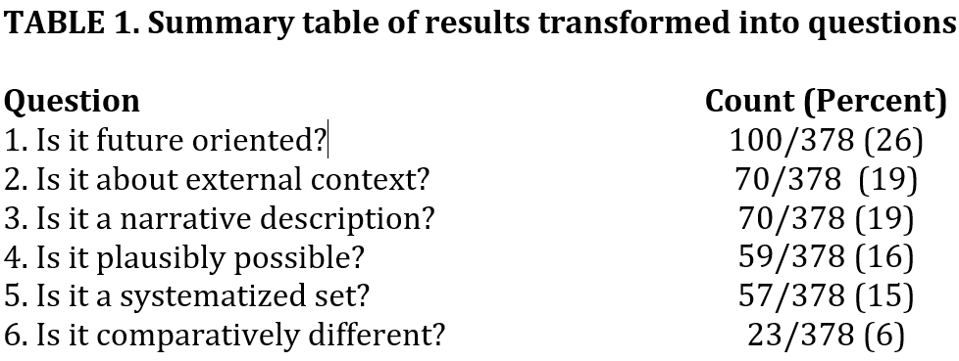
Summary of results as questions
Is it future oriented? 100/378 (26%)
Is it about the external environment? 70/378 (19%)
Is it a narrative description? 70/378 (19%)
Is it plausibly possible? 59/378 (16%)
Is it a systematized set? 57/378 (15%)
Is it comparatively different? 23/378 (6%)

Slide 13
Is the described phenomenon…
If NO, then it may be, but is not limited to…
future oriented?
NO
Counterfactual; Nowcast
about the external context?
NO
Pre-factual; Option evaluation; Management dilemma; Leadership “vision”
a narrative description?
NO
Trend extrapolation; Forecast; Model simulation;
Sensitivity analysis; Consensus forecast
plausibly possible?
NO
Science fiction; Future fantasy; Dystopia; Utopia
a systematized set?
NO
Prediction; What-if? Contingency; Baseline scenario; Backcast
comparatively different?
NO
Sharing the same cluster or island on heat maps built by morphological boxes
SCENARIO
In the intuitive logics tradition
Spaniol, Matthew J. & Rowland, Nicholas J. (2018) Defining scenario. Futures and foresight science
Notes:
Counterfactual – used in history;
Prognosis
Prophecies
nowcast – runaway trolley problem in moral philosophy –there are 5 people about to get run over, but you happen to be standing at the switch – but on the other track there is one person…
;

Slide 14
Matt@mgmt.au.dk
@matthewspaniol
Thank you
Matthew J. Spaniol, PhD
Nicholas J. Rowland, PHD
      “Defining Scenario”
        (2018) Futures. & Foresight Science
      “The Scenario Planning Paradox”
        (2018) Futures
      “Social Foundations of Scenario Planning”
        (2017) Technological Forecasting & Social Change.
      “The Future Multiple”
        (2015) Foresight.
Notes:
Thanks for listening,
Like to hear what you think – do you agree?
Leave a comment
Link to the paper
In case you want to use the slide slideshare – try it out on your colleagues

